Slide 1
Perry Park East HOA Annual Meeting
September 21st
7:00 PM
Bear Dance Club House

Slide 2
Agenda
Welcome & Board Member Intros Doug Corley
New Neighbor Welcome
Covenants
2021 Activities
Financial Report: John Hellickson
Guest Speakers:
Sean Dodd Colo Parks & Wildlife, Wildlife Officer
Zac Schmidt Thrive Broadband, internet access
Adjournment

Slide 3
PerryParkEast.ORG ppehoa@yahoo.com
NAME
Paul Erickson
John Hellickson
Hank Wilcox
Doug Corley
Tracy Amidon
Colin Condon
Jon Martin

Slide 4
HOA Overview: Activities
1. Review CONSTRUCTION, EXTERNAL REMODELING
(ACC – Architectural Control Committee)
2. COVENANT COMPLIANCE
(Nuisance + Dispute Resolution)
3. CHIPPING/SLASH PROGRAM
(Fire Mitigation)
4. COMMUNITY EVENTS
(BBQ picnics, Annual Meeting)

Slide 5
PerryParkEast.ORG ppehoa@yahoo.com
WHERE ARE THE RULES ?
PROTECTIVE COVENANTS
RULES + REGULATIONS
ARCHITECTURAL CONTROL
Established POLICIES
Clarifying GUIDELINES
External REMODEL / CHANGES

Slide 6
Covenant Compliance
Lighting
Fencing
Signs
Parking
Out Buildings
Animals
Trees
Nuisances

Slide 7
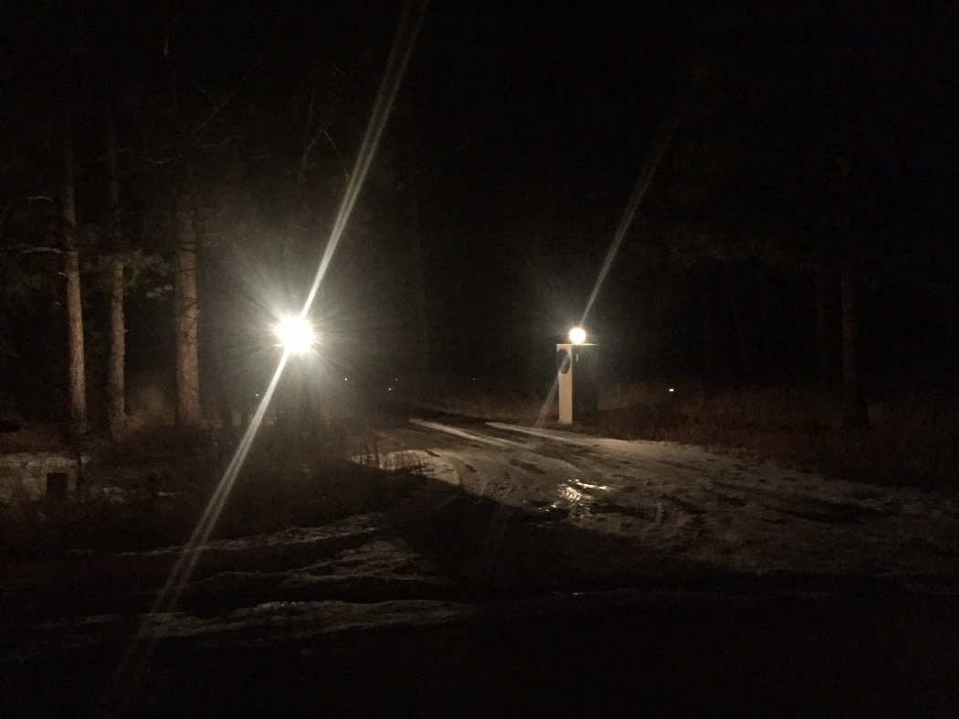
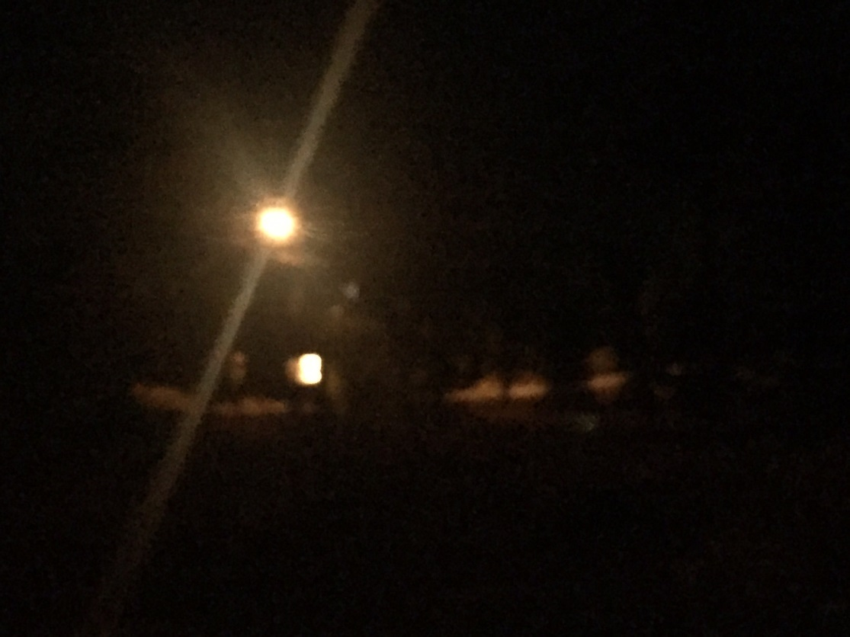
Lighting Issues

Slide 8
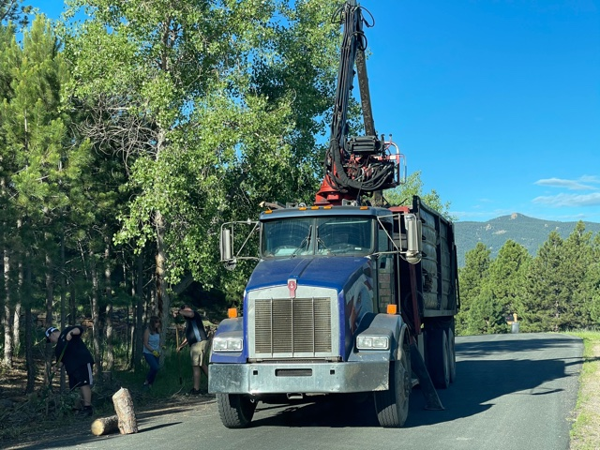
Chipping vs Hauling
M.R. Hauling Cost--$5700
Chipping Cost(spring and fall)--$1900
Notes:
12 Truckloads

Slide 9
2021 PPE HOA Financials
Account | April 2019 | September 2021
Checking | $ 5,125.68 | $ 3,644.94
Savings | $ 17,089.79 | $ 15,347.53
Total | $ 22,215.47 | $ 18,992.47
2021 HOA Dues Collected: $ 3,350
Key Difference 2019 vs 2021
Hauling Costs ($ 5,700)
Extra Charges Collected - Large Piles +$ 1,060
Chip vs Haul = ($2,740)
Notes:
~40% HOA dues paid

Slide 10
PerryParkEast.ORG ppehoa@yahoo.com
NAME
Paul Erickson
John Hellickson
Hank Wilcox
Doug Corley
Tracy Amidon
Colin Condon
Jon Martin
We’d love your help
Can we call you?

Slide 11
Guest Speakers:
Sean Dodd
Zac Schmidt

Slide 12
Thank you for participating
and being a valuable member
of both our HOA
AND our community!

